Slide 2
Digital Forensics Lecture-26
By- Dr.subhranil Das
Assistant Professor
School of computer Science

Slide 3

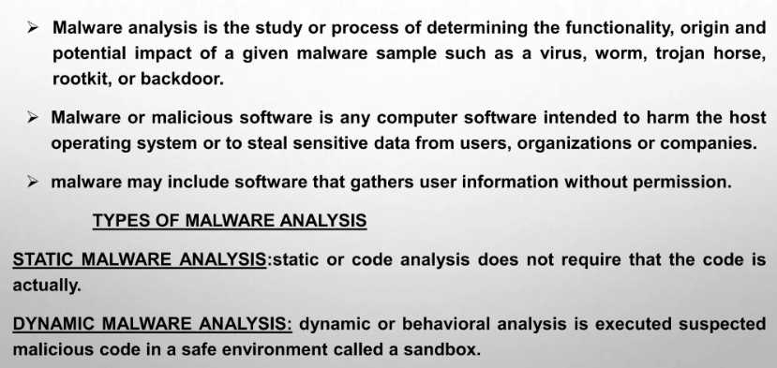
Malware Analysis

Slide 4
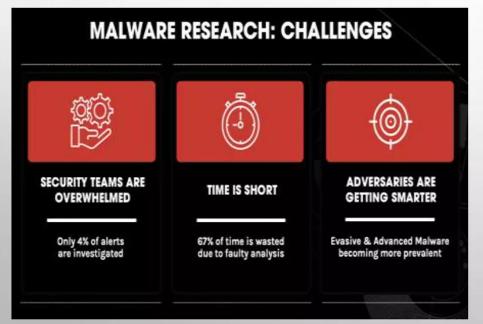
Malware Analysis: Challenges

Slide 5
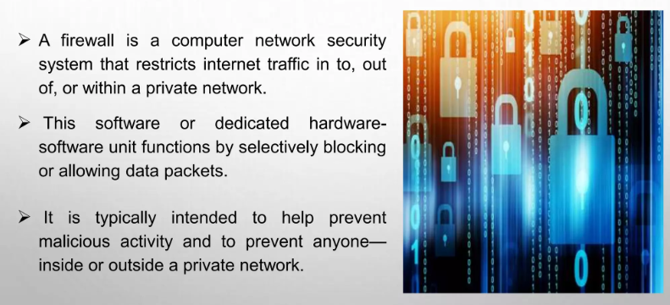
Firewall Malware

Slide 6
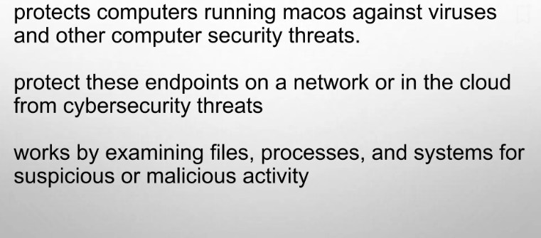
Endpoint Security

Slide 7
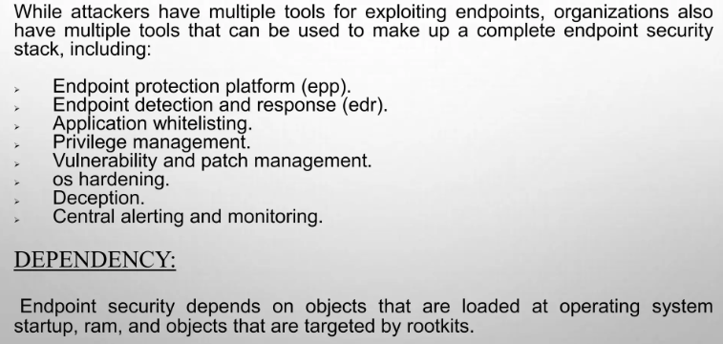
Endpoint Security

Slide 8
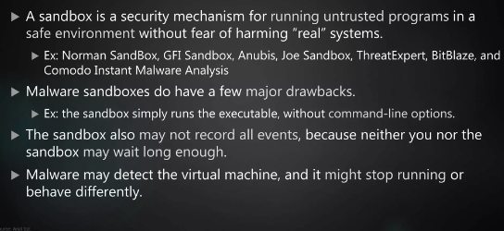
SandBox

Slide 9
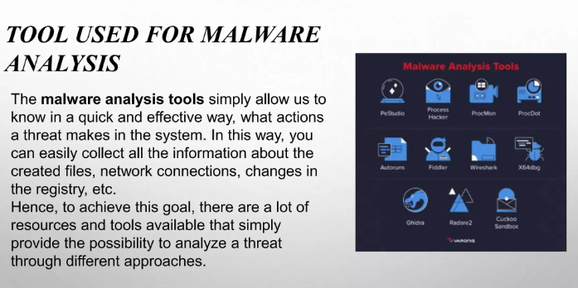
Tools for Malware Detection Analysis

Slide 10
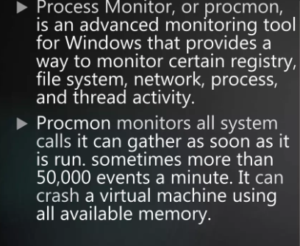
Process Monitor

Slide 11
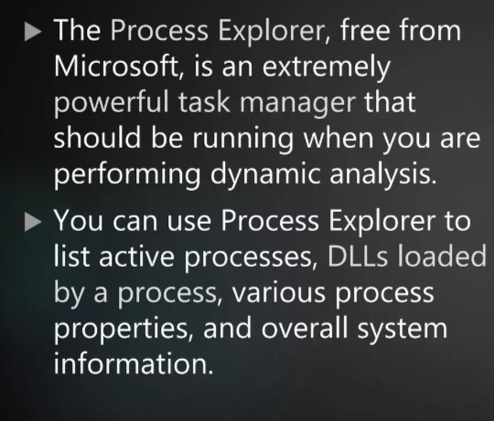
Process Explorer

Slide 12
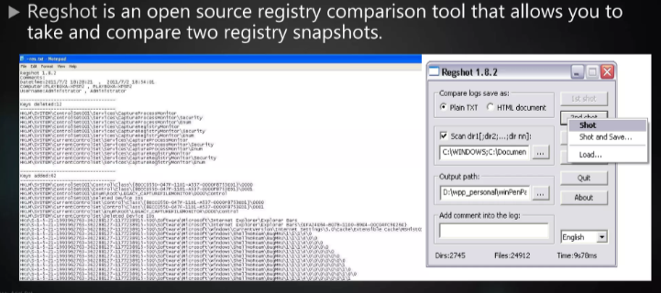
Registory Snapshot

Slide 13
Next Lecture
Behavioral Analysis
.

